Slide 1
We trust in the Community!
Ravikanth chaganti

Slide 2
5
Video operator, did you start the recording?

Slide 3
4

Slide 4
3

Slide 5
2

Slide 6
1

Slide 7
We trust in the community!
Ravikanth Chaganti

Slide 8
Agenda
Community!
Community!
Community!
…
…
…
…
Community!

Slide 9
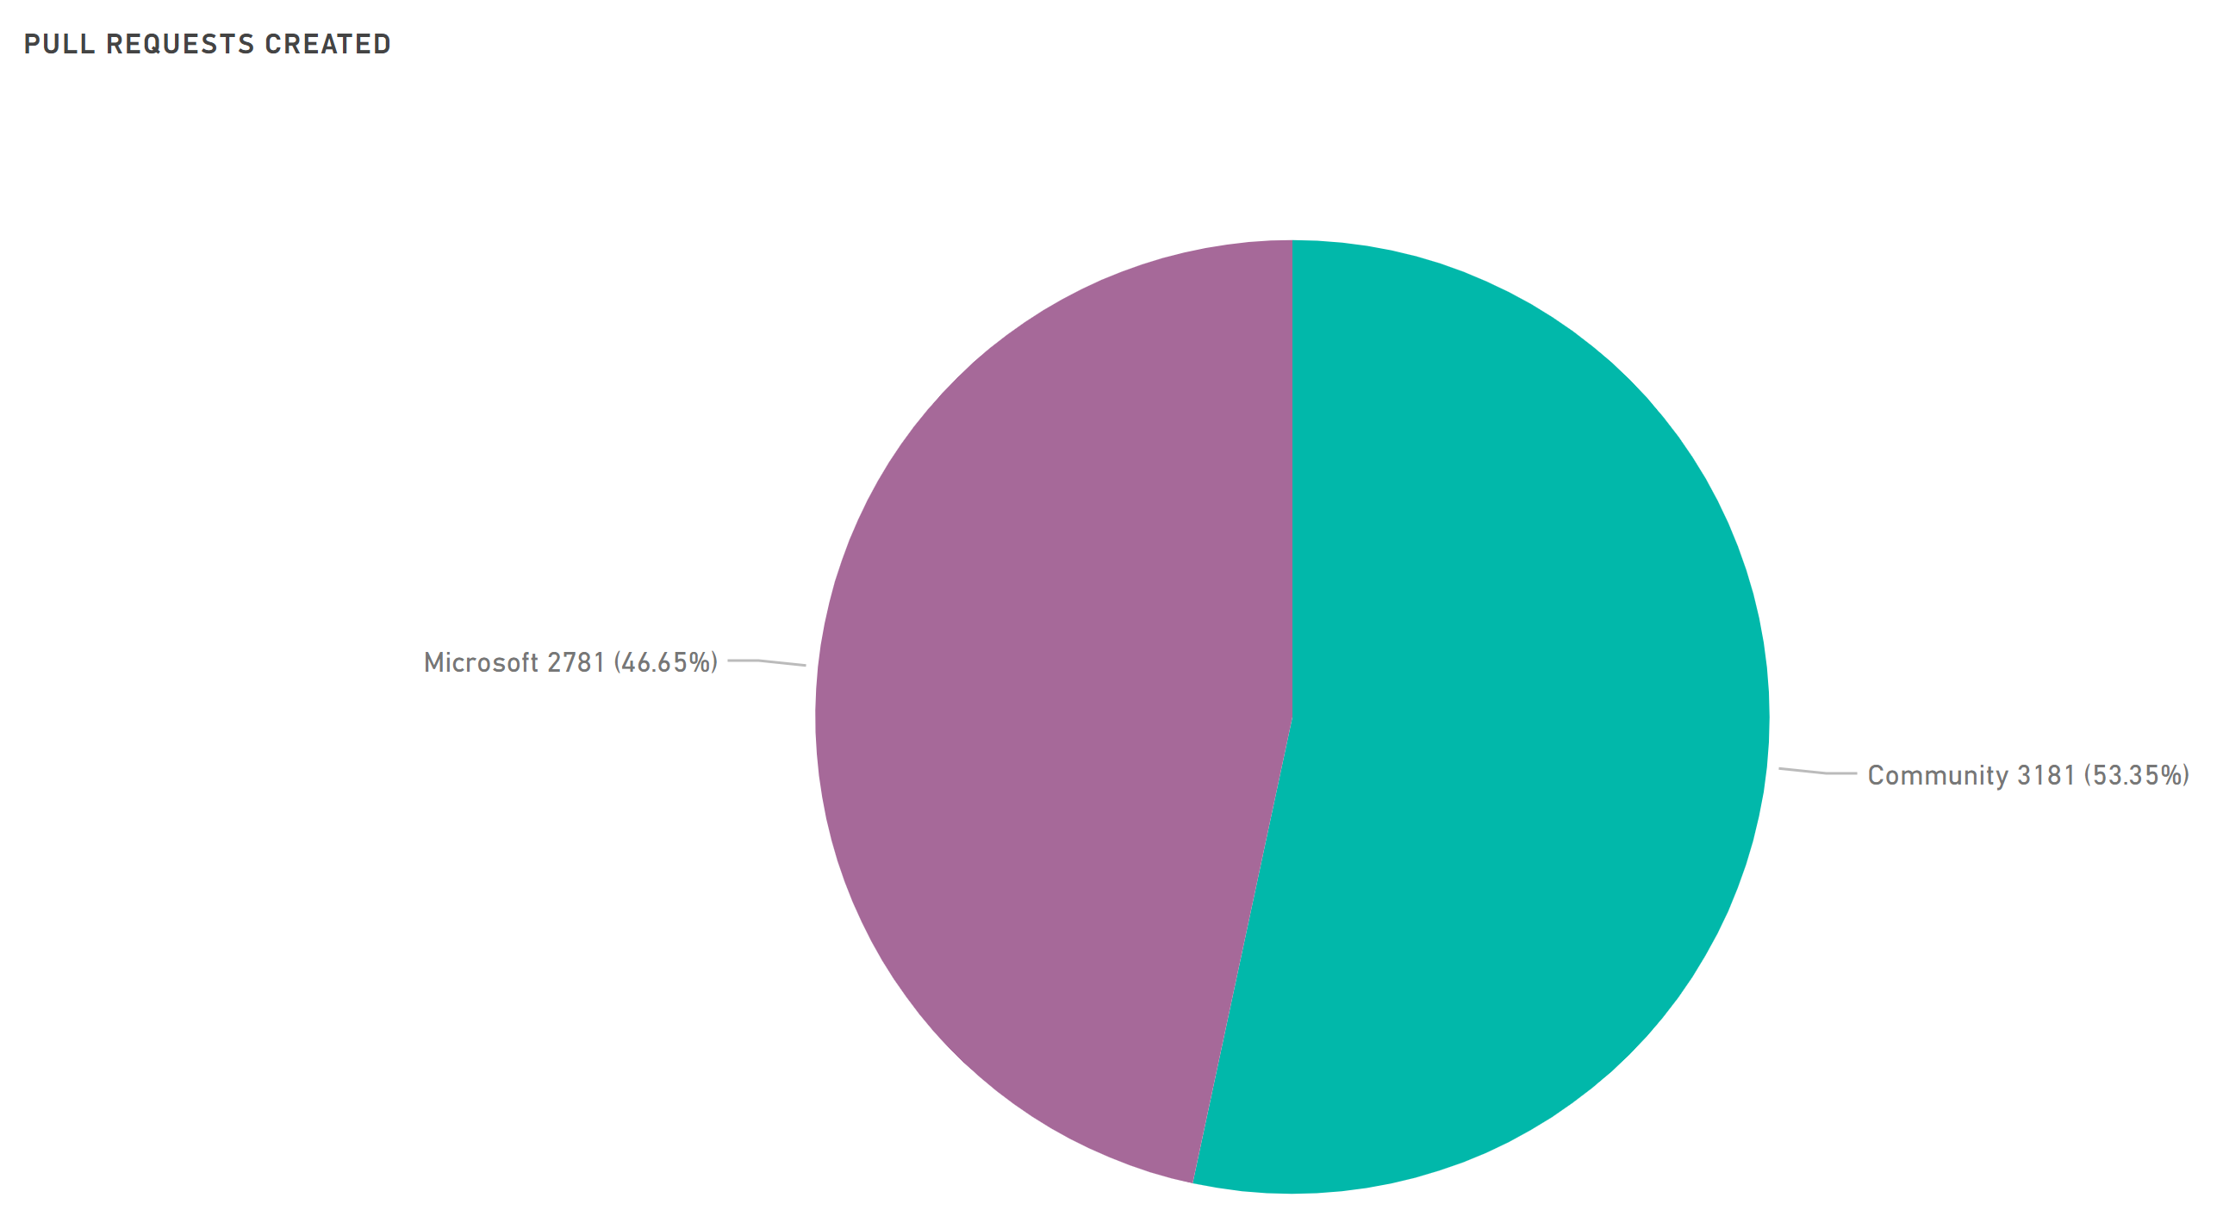
PowerShell Repository

Slide 10
Community Avenues
Community blogs
Books
Conferences / User Groups
Live Streamers
Forums
Community Open Source Modules

Slide 11
Community Open Source Modules
4K+ modules in PowerShell Gallery
100s more may be in GitHub repositories!
Excellent support from community members

Slide 12
PSKoans
https://github.com/vexx32/PSKoans

Slide 13
ImportExcel

Slide 14
Polaris and PSHTML

Slide 15
PSGraph

Slide 16
Summary
The most powerful community
PowerShell Open Source Community Dashboard: http://aka.ms/PSGitHubBI

Slide 19
about_Speaker
Distinguished Member Technical Staff at Dell EMC
Multi-year Microsoft MVP (PowerShell)
Published Author
Founder and Editor of PowerShell Magazine
github.com/rchaganti
linkedin.com/in/rchaganti/

